Slide 1
Simulation of Photovoltaic Systems: Optimization Algorithms and Simulation Framework
MSc in Energy Systems
Dissertation Presentation
Author: Konstantinos Georgiou
Date: July 2025
Supervisor: Dr.Kavadias Kosmas

Slide 2
Presentation Outline
Introduction & Background
Scope of the Work & Research Objectives
Methodology
Optimization Results & Analysis
Validation, Contributions & Conclusions

Slide 3
Introduction - Background
The Energy Mismatch Problem
Solar PV systems produce energy primarily during midday hours where solar irradiance is at the maximun, but sometimes
the facility energy demand peaks during morning and evening hours.
Result: Poor synchronization between energy production and consumption
Consequences:
Excess energy exported to grid at low feed-in tariffs
Grid dependency during peak demand periods (expensive electricity)
Increased need for energy storage systems
Higher costs for batteries, maintenance, and system complexity

Slide 4
Scope of the Work
Primary Goals:
Develop sophisticated simulation framework for PV systems using physical modeling
Implement multi-objective optimization using evolutionary algorithms
Balance energy production maximization with consumption pattern matching
Integrate battery storage optimization and economic analysis
Provide practical guidance for optimal PV system integration
Work Flow
PV System Simulation Framework
⬇
Multi-Objective Optimization (NSGA-II)
⬇
Battery Integration & Economic Analysis
⬇
Decision Support & Implementation Framework

Slide 5
Research Objectives
Core Research Question
How to optimize PV system design (orientation and battery sizing) to simultaneously maximize energy production, minimize consumption mismatch, and achieve optimal economic returns?
Expected Contributions:
Advanced simulation methodology
Multi-objective optimization framework
Battery integration strategy
Practical optimization guidelines
Economic viability assessment
Decision-making framework
Output: Optimal PV system configuration with economic and technical performance metrics

Slide 6
Methodology - Part 1: Data Processing & Solar Modeling
Step 1: Input Data Processing
Clean and transform TMY meteorological data (8,760 hours)
Load building consumption profiles (kW)
Validate data quality and handle missing values
Step 2: Solar Position Calculation
Calculate sun position (zenith, azimuth angles) using SPA algorithm
Determine daylight hours (zenith < 90°)
Generate solar geometry for all 8,760 hours
Step 3: Solar Irradiance Modeling
Calculate DNI from GHI using DISC Model
Compute plane-of-array irradiance using Hay-Davies Model
Step 4: PV Energy Production Calculation
Sharp ND-R240A5 panel modeling (240W, 14.6% efficiency)
Cell temperature calculation using NOCT method (47.5°C)
Apply system losses (soiling, shading, temperature, inverter)
Step 5: Load Matching Analysis
Calculate weighting factors using adaptive strategy
Combine temporal, load, and solar components
Assign importance weights to different hours based on consumption patterns
𝑤(𝑡)=𝑤_𝑡𝑒𝑚𝑝 (𝑡)∙𝑤_load ∙(𝑡)𝑤_production (𝑡)

Slide 7
Methodology - Part 2: Optimization & Analysis
Step 6: Multi-Objective Optimization
NSGA-II algorithm with population size 50, 30 generations
Objective 1: Minimize weighted energy mismatch
Objective 2: Maximize total energy production
Variables: Tilt angle (0-60°), azimuth angle (90-270°)
Generate Pareto front of optimal trade-off solutions
Step 8: Economic Analysis
Calculate initial investment (panels, inverter, battery, installation)
Annual cash flow modeling over 25-year lifetime
Financial metrics: NPV, IRR, payback period, LCOE
Performance metrics: Self-sufficiency,
self-consumption rates
Step 7: Battery Sizing Simulation
Hourly energy flow simulation for capacities 1-100 kWh
Battery parameters: 90% efficiency, 80% depth of discharge
Economic viability filter: Payback period ≤ 10 years
Selection criteria: Maximum NPV among viable options
Step 9: Results Analysis & Validation
Seasonal performance analysis (winter, spring, summer, fall)
Sensitivity analysis for key parameters
Validation against PVGIS and industry benchmarks
Generate comprehensive reports and visualizations

Slide 8
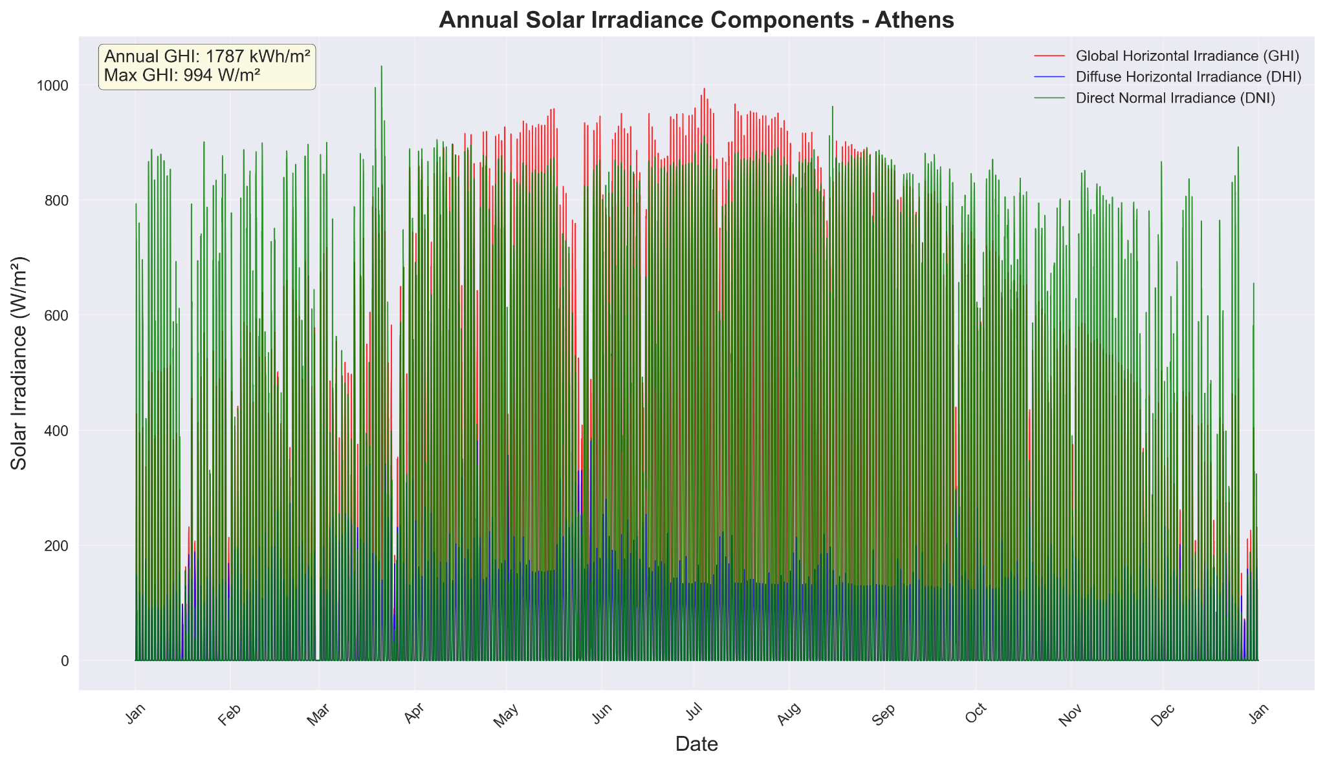
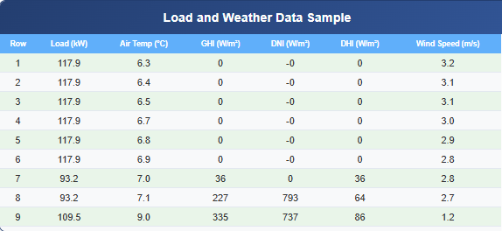
Input Data: Load and Weather Data

Slide 9
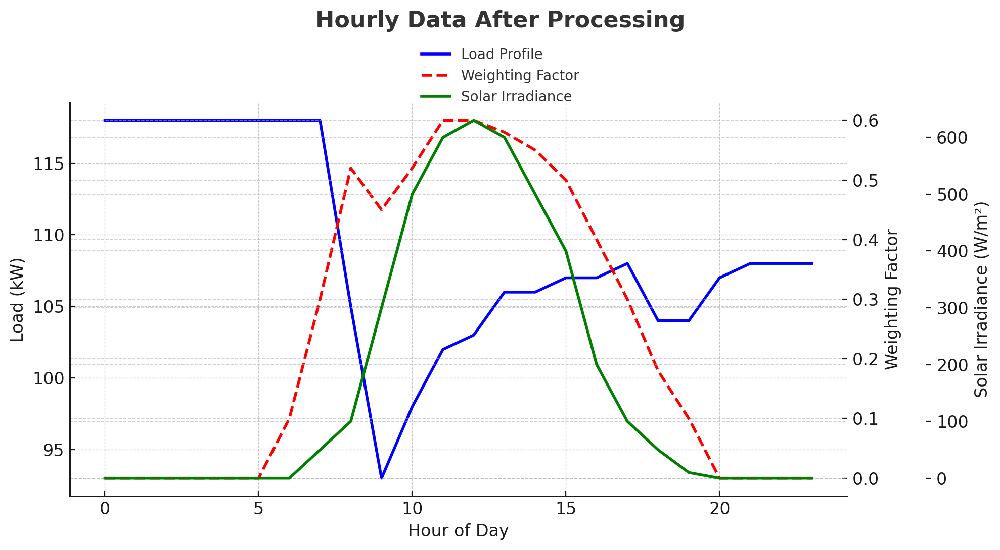

Slide 10
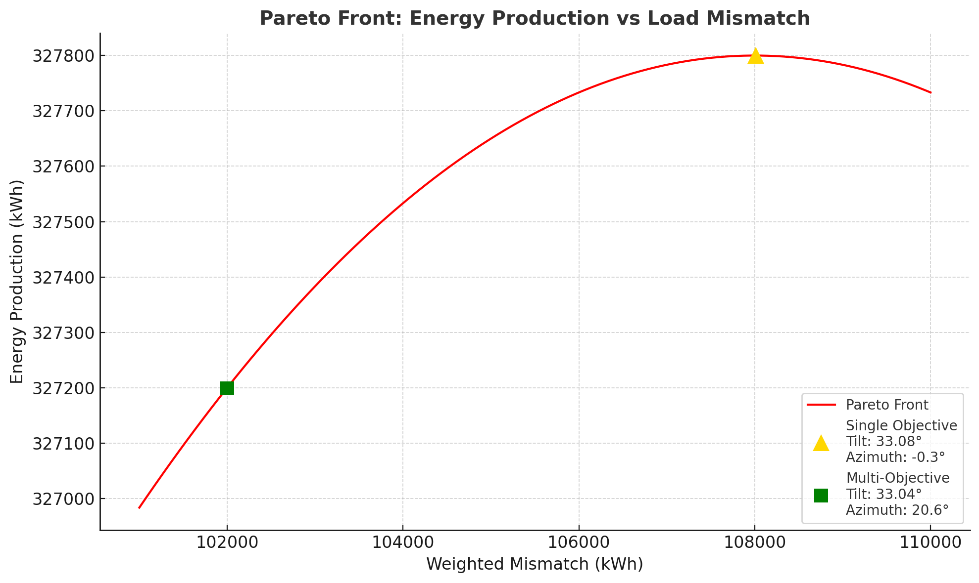

Slide 11
Optimization Results & Performance
Optimization Strategy Tilt Angle Azimuth Angle Annual Energy (kWh) Load Matching
Single Objective 33.8° -0.3° 327,731 Standard
Multi-Objective 26.9° 20.6° 321,919 + 5.8%
Selected Final Configuration
Strategy Used: adaptive_improved
Final Production: 321,919 kWh/year
Final Angles: 26.9° tilt, 20.6° azimuth
Energy Loss: -5,812 kWh (-1.8% vs single-objective)
Weighted Mismatch: ~102,000(kWh) vs 108,289 (kWh)
Load Matching Benefit: Significant westward azimuth shift for afternoon production

Slide 12
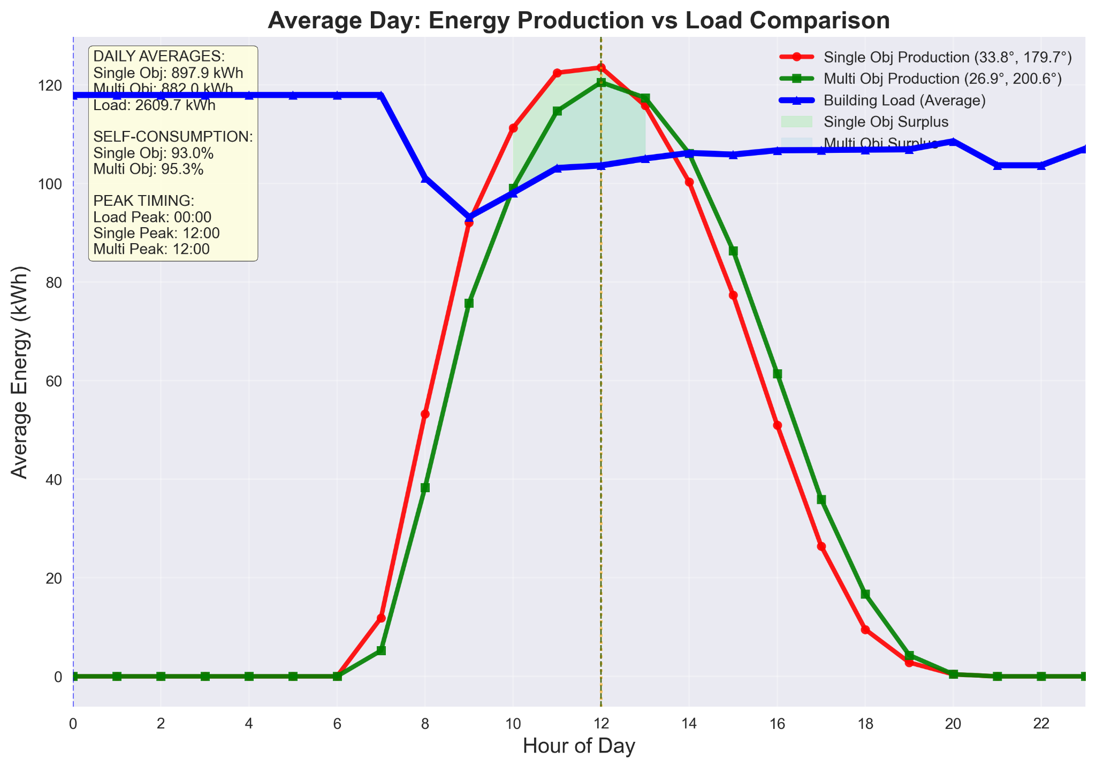

Slide 13
Optimization Results & Performance
Optimization Strategy Tilt Angle Azimuth Angle Annual Energy (kWh) Load Matching
Single Objective 33.8° -0.3° 327,731 Standard
Multi-Objective 33.4° 41.7° 310,455 +6.1%
Selected Final Configuration
Strategy Used: adaptive_improved
Final Production: 310,455 kWh/year
Final Angles: 33.4° tilt, 41.7° azimuth
Energy Loss: -17,276 kWh, -5.3%
Weighted Mismatch: ~179,170 kWh vs 190,863 kWh
Load Matching Benefit: Significant westward azimuth shift for afternoon production

Slide 14
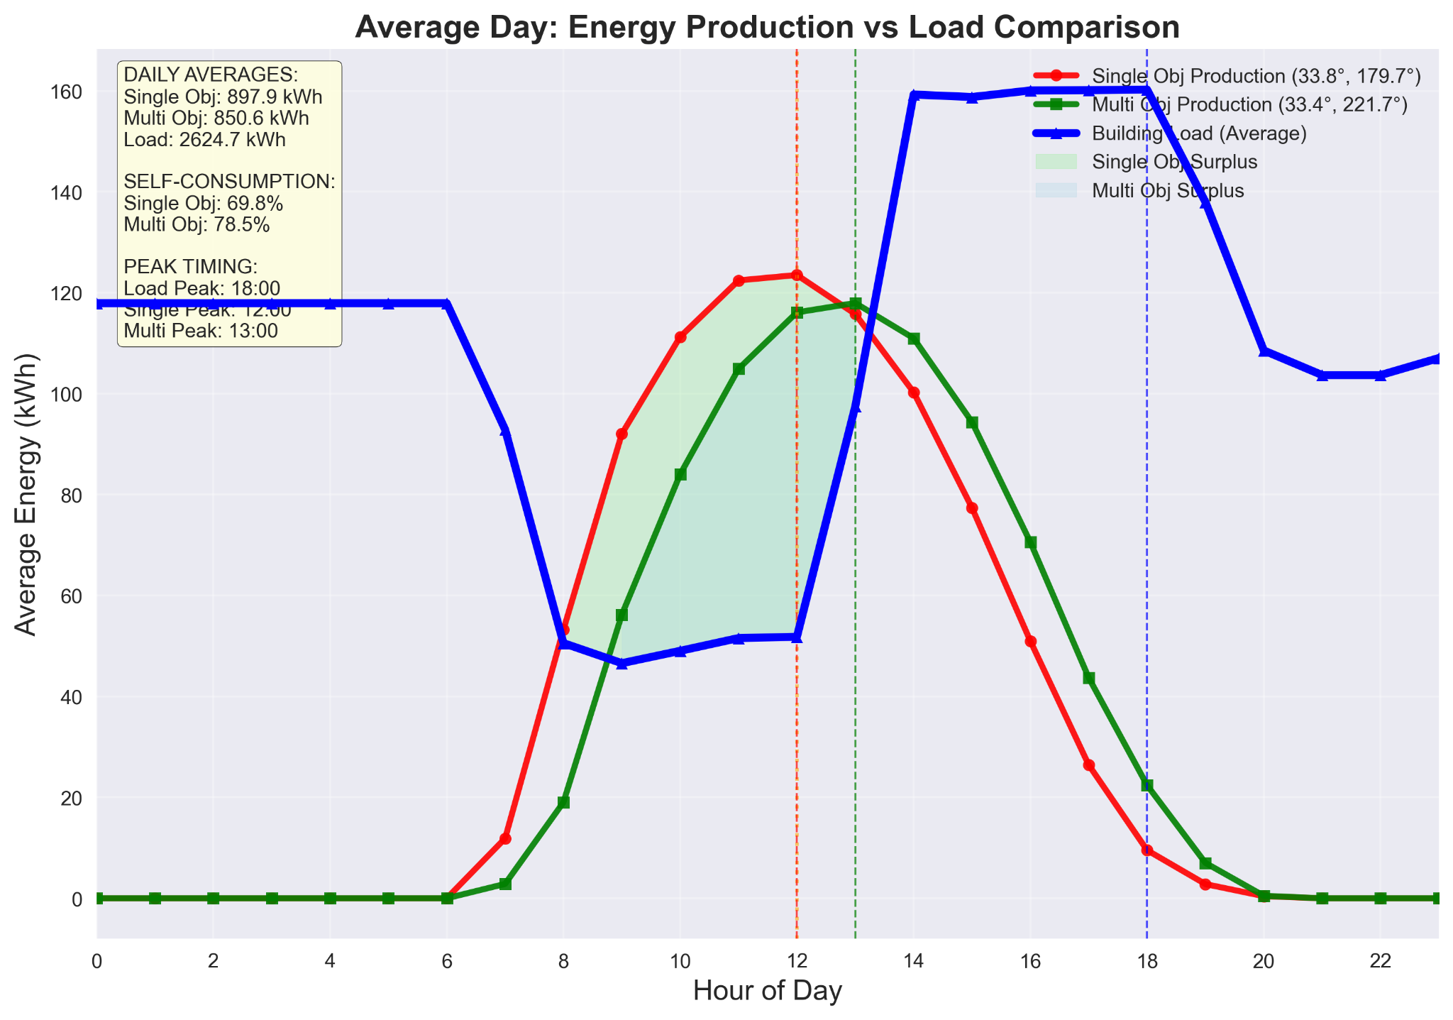

Slide 15
Optimization Results & Performance
Optimization Strategy Tilt Angle Azimuth Angle Annual Energy (kWh) LoadMatching
Single Objective 33.8° -0.3° 327,731 Standard
Multi-Objective 52.3° 78.0° 280,333 +26.7%
Selected Final Configuration
Strategy Used: load_matching
Final Production: 280,333 kWh/year
Final Angles: 52.3° tilt, 78.0° azimuth
Energy Loss: -75,327 kWh, -23.0%
Weighted Mismatch: 139,879 kWh vs 190,863 kWh
Load Matching Benefit: Significant westward azimuth shift for afternoon production

Slide 16
Battery Strategy Comparison: Single vs Multi-Objective
Strategy Optimal Battery (kWh) Investment (€) Annual Savings (€) Payback (years) Self Sufficiency(%)
Single-Objective 12.5 5,000 505 10.11 22.6%
Multi-Objective 7.5 3,000 295 9.9 24.5%
Single-Objective Strategy (Max Production)
Battery Size: Larger capacity (12.5 kWh)
Approach: Store maximum surplus energy
Trade-off: Higher investment for marginal gains
Result: €2,000 higher investment, lower self-sufficiency
Multi-Objective Strategy (Load Matching)
Battery Size: Optimized capacity (7.5 kWh)
Approach: Match generation with load timing
Advantage: Better load alignment efficiency
Result: €2,000 cost savings, 1.9% higher self-sufficiency

Slide 17
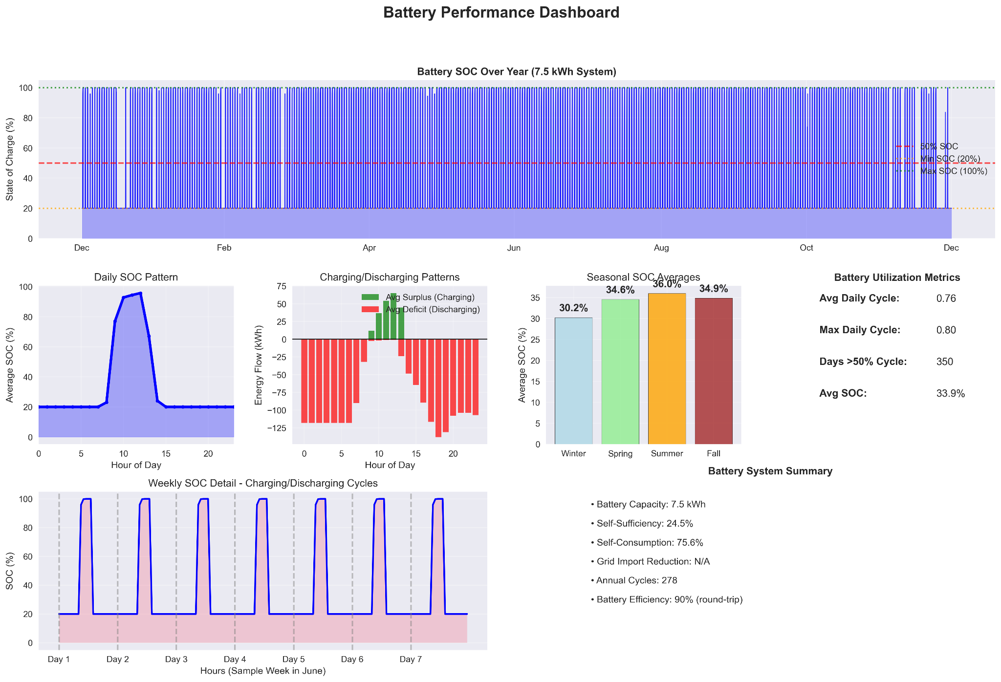

Slide 18
Economic Performance - Financial Metrics & ROI
Component | Cost | Percentage
PV Panels | €125,808 | 52.4%
Inverter | €55,770 | 23.2%
Installation | €41,828 | 17.4%
Battery (7.5 kWh) | €3,000 | 1.2%
BOS & Other | €13,616 | 5.7%
Total Investment | €240,022 | 100%
Metric | Value
Net Present Value (NPV) | €6749
Internal Rate of Return (IRR) | 13.9%
Payback Period | 3.9 years
LCOE | €0.078/kWh
Annual Savings (Year 1) | €62,065

Slide 19
System Performance Summary - Overall Metrics & Key Findings
Parameter | Value | Optimization Impact
PV Capacity | 202.8 kWp (845 panels) | Sharp ND-R240A5
Optimal Tilt | 33.4° | Remains almost the same for the balanced strategy
Optimal Azimuth | 20.6° (Southwest) | 20.9° westward shift
Battery Capacity | 7.5 kWh | Economically optimized
System Efficiency | 11.2% | Including all losses

Slide 20
Limitations of the Project
Data & Climate
Historical Weather Data: Based on past patterns, assuming future similarity
Climate Variability: Long-term changes could impact system effectiveness
Static Load Profiles: Single representative profile with limited variations
System Modeling Simplifications
PV Module Degradation: Not dynamically simulated over lifespan
Shading Effects: Not dynamically modeled
Battery Aging: Simplified degradation modeling
Grid Constraints: Perfect grid integration assumed
More dynamically modeling of weather system

Slide 21
Optimization Boundaries
Variable Scope: Limited to tilt, azimuth, and battery capacity
Technology Exclusions: No tracking systems or advanced technologies
Load Flexibility: No demand response modeling
Economic Model Constraints
Static Economic Assumptions:
Fixed electricity pricing over 25 years
Constant inflation rates
Stable feed-in tariffs
No dynamic market fluctuations
These limitations represent opportunities for future research and model enhancement while maintaining the validity of current findings within the defined scope

Slide 22
Comparison with Similar Research Works
Study | Method | Key Results | Our Work Comparison
Kichou et al. (2020) | Load matching indicators | 24-68% self-sufficiency, IRR 6.1-6.4% | 24.5% self-sufficiency
Vigkos & Kosmopoulos (2024) | Athens PV analysis | 1571.72 kWh/kWp, 32° tilt | 1587 kWh/kWp, 33.4° tilt
Ciocia et al. (2021) | Italy PV+battery | 38-65% self-sufficiency, IRR 6.3-11.2% | IRR 13.9%
Hlal et al. (2019) | NSGA-II optimization | Higher accuracy than MOPSO | NSGA-II validation

Slide 23
What the Assessment Shows:
Technical Validation:
Self-sufficiency (24.5-3%) matches literature baseline
Energy yield (1587 kWh/kWp) very close to Athens benchmark (1571.72)
Load matching improvement (5.8%-26.7) within published range (5.8-20%)
NSGA-II methodology validated against other studies
Limitations (Financial Mismatch):
IRR (13.9%) exceeds literature range (6-11%)
Payback (3.9 years) shorter than most published benchmarks (4.5-12 years)
Technical performance metrics align well with established literature, validating the methodology and optimization approach. The NSGA-II algorithm demonstrates effectiveness consistent with published studies.
The simplification of the financial model as well as overestimation in financial assumptions lead to optimistic results, making the project to appealing.

Slide 24
Conclusions
Key Achievements
Comprehensive Workflow: Created and implemented integrated approach combining calculation of the number of PV panels that fit in the available area, solar optimization, battery sizing, and economic analysis
Optimization Impact: Multi-objective approach significantly enhances system performance through balanced trade-offs
Decision Framework: Evidence-based approach for stakeholder-specific recommendations
Research Impact
Practical Application: Methodology adaptable for different climates and site constraints
Industry Relevance: Provides actionable guidance for PV system designers and investors
Academic Contribution: Advances multi-objective optimization in renewable energy
Future Research Directions
Dynamic Tracking Systems: Possible increase in load matching performance
Hybrid Energy Systems: Combining PV with wind power and advanced storage
Machine Learning Integration: Self-adaptive forecasting and optimization
Multi-Objective optimization includes more objectives(costs, economic returns, etc)

Slide 25
Final Impact Statement
This work advances renewable energy by offering a comprehensive and replicable method that integrates PV orientation optimization, battery sizing, and economic analysis. The research demonstrates that intelligent multi-objective optimization can achieve better load matching with minimal energy sacrifice, reducing storage requirements while providing a solid foundation for context-aware renewable energy system design

Slide 26
Thank You for Your Attention
Questions & Discussion
Konstantinos Georgiou
MSc in Energy Systems
University of West Attica & Heriot-Watt University
Simulation of Photovoltaic Systems:
Optimization Algorithms, Battery Integration,
and Economic Analysis Framework

